Slide 1
Images of Aging Project
Trevor Barrow, Smarak Pattnaik

Slide 2

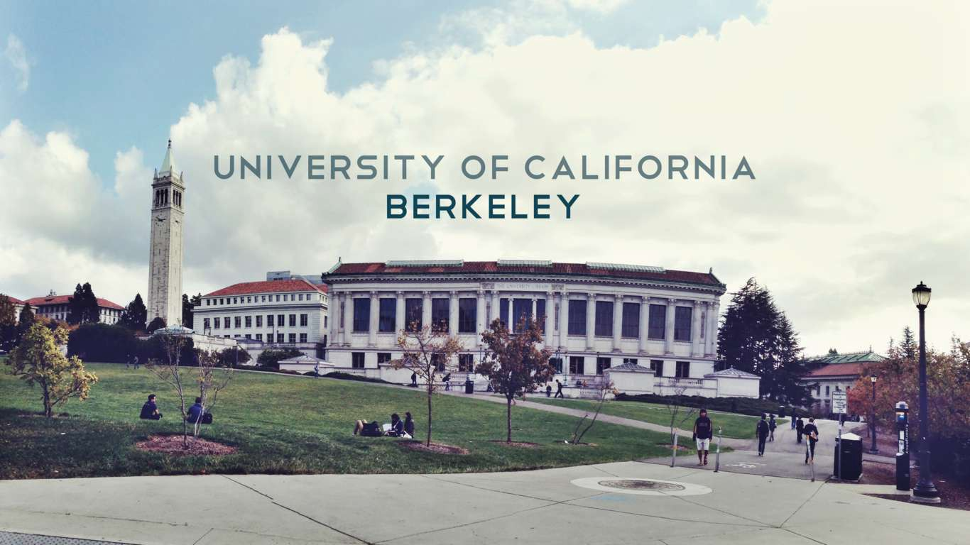
Our Team
Mark Borgschulte, Professor of Economics
The UC Berkeley Team

Slide 3
CEOs
+
Politicians
Do they age faster?
Notes:
To determine if Fortune 500 CEOs and US politicians over the past 100 years age at a different rate than the average person, and if so, to determine what said rate would be.

Slide 4
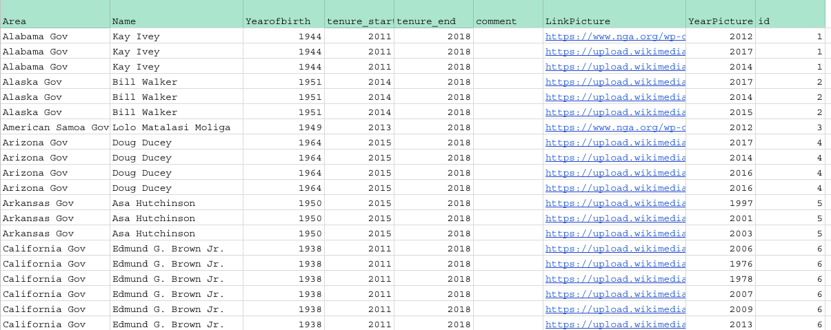
1. Collect Photos

Slide 5


2. Python code
3. Calculate
-> Facial recognition software
-> Age estimations
Notes:
2. Put those through Python code to produce age estimations from facial recognition software built by amazon and microsoft. (thank you so much for allowing us to use your product to analyse you XD)
3. Calculate the necessary measurements (mean squared error, standard deviation, average error etc) using Excel for analyzing the data.

Slide 6
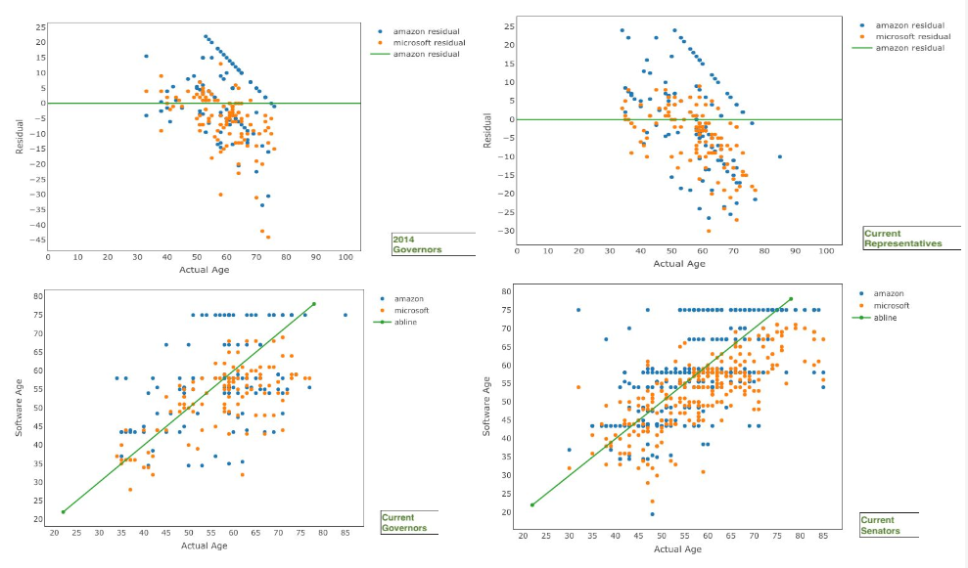
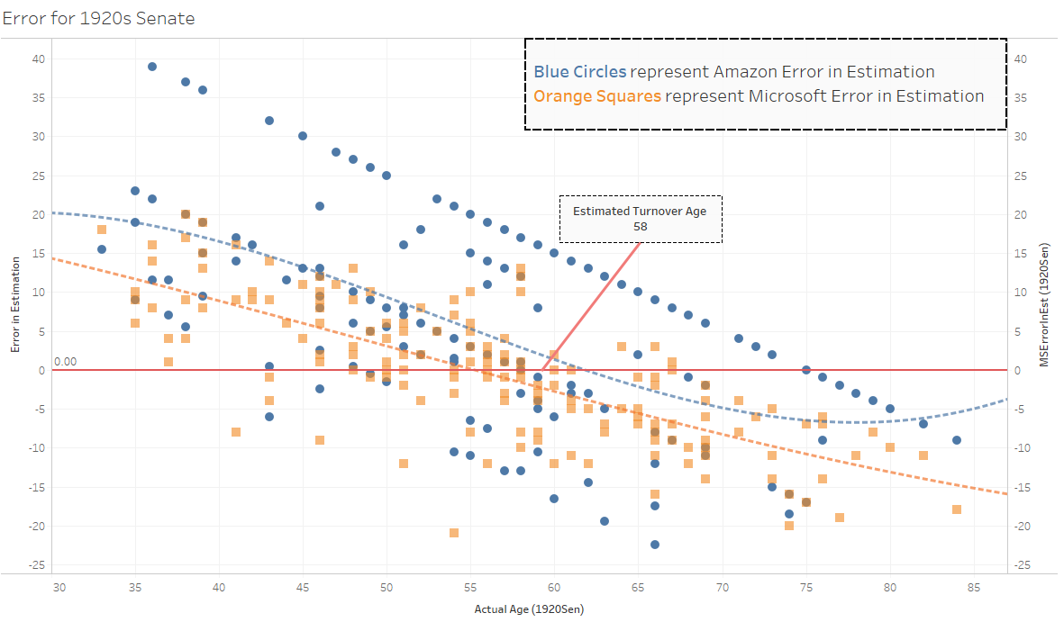
4. Data visualization
Notes:
Use data visualization programs (R, Python, Tableau) to make sense of everything.

Slide 7
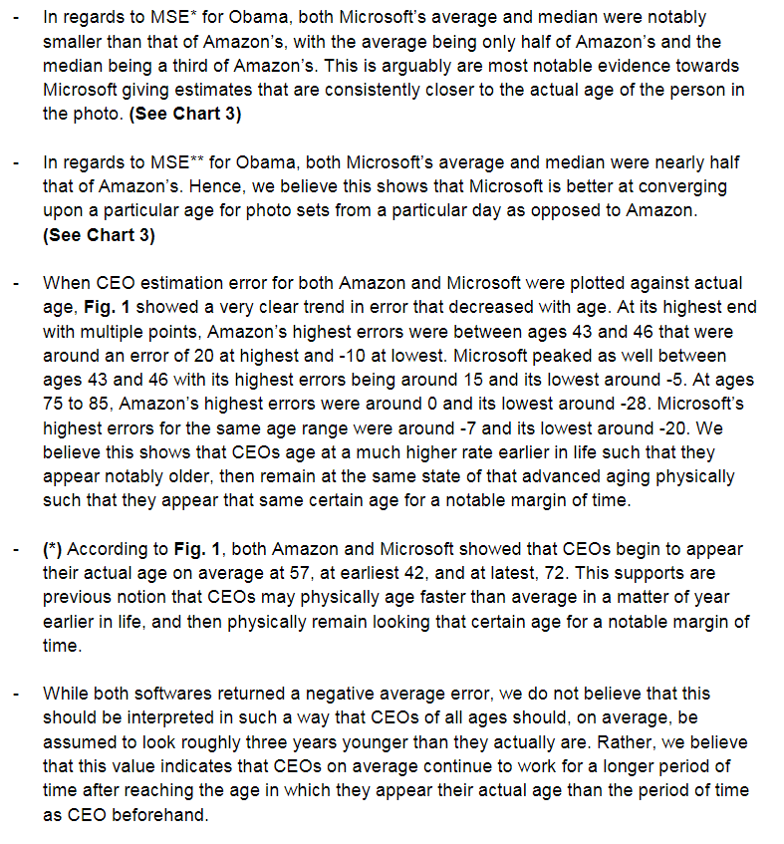
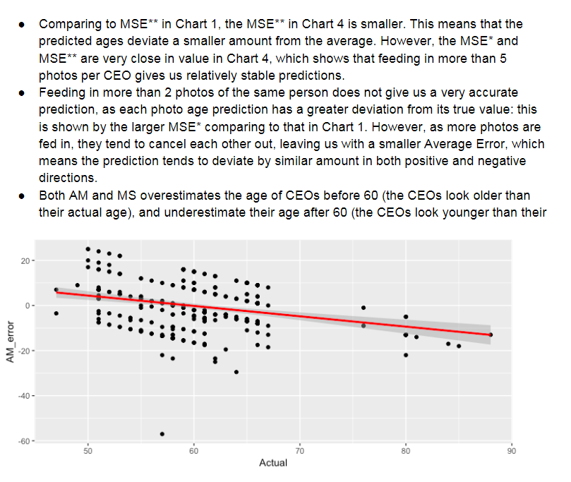
5. Analyze
Notes:
5. Analyze the visualized data for trends and determine their significance.

Slide 8
This Semester
Wanted to determine degree of influence of certain photographic elements on error in age estimation.
Manually rated and determined presence of said elements in entire data set (2500+ photos).
Investigated influence via data visualization and analysis.
Worked with new Orange software rather than that of Amazon and Microsoft.
Notes:
Our goal this semester was to focus on the CEO age approximations and primarily determine if there were any photographic elements that caused some kind of error in the age approximation. To do this (read point 2). We investogated our data through visualizations on tableau and stata. We aso worked with a new facial recognition software called Orange software instead of the Microsoft and Amazon facial recognition software

Slide 9

Usefulness of Orange
Gives 11 estimations per photo rather than 1.
Each estimation is based upon a different training sample.
Each estimation goes to 6+ significant digits rather than being an integer.
High precision among single photo estimations, calculated by maximum estimation difference.
Notes:
Reason why we decided to use the orange software instead of the Amazon and Microsoft facial recognition software was because (first 3 points).
Each of the 11 estimations are highly precice and due to that they are mostly very similar. Although each estimation is based on an uniquely trained data set, they all produce very similar age approximations, thereby ensuring validity of the findings.

Slide 10
3.0
3.3
1.8
Median
Average
Standard Deviation
Notes:
For our entire data set consisting of 2500 pictures, we have a median range among the 11 approximations was 3 years with a standard deviation of 1.8 years

Slide 11
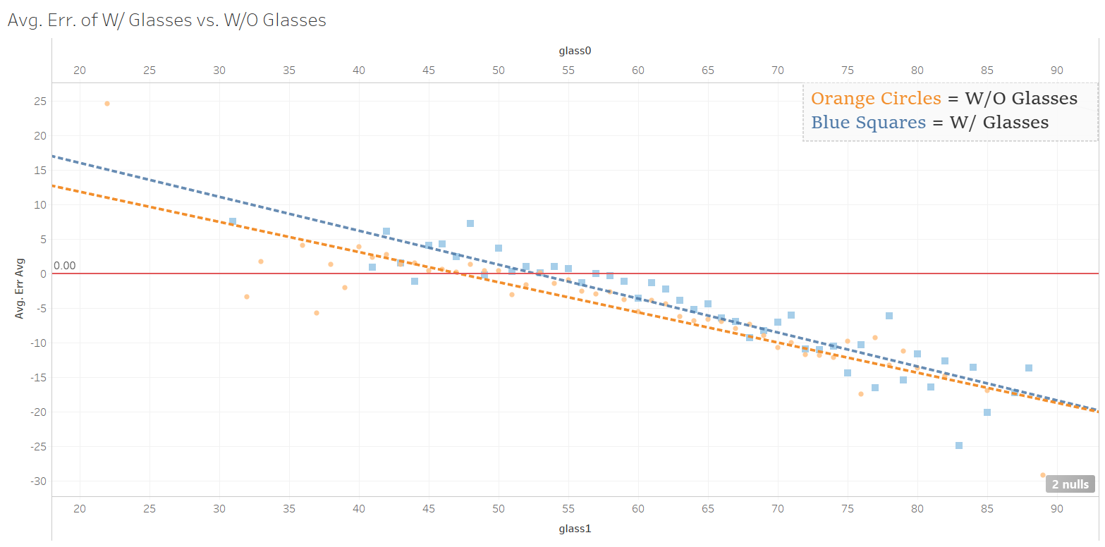
Average Error per CEO Age,
W/ Glasses
Vs
W/O Glasses:

Slide 12
Hypothesis for W/ Glasses vs. W/O Glasses
Hypothesized that glasses would cause subjects to consistently be estimated as older/’less young’ than subjects without glasses.
Believed Orange would see glasses as accentuated facial features, causing them to appear as older.
Notes:
We say less young here since there is a point where all subjects are rated as younger than they actually are, and thus, one group will have a less severe negative error, such that they are ‘less young’ than the other group.

Slide 13
Observations for W/ Glasses vs. W/O Glasses
Largest substantial difference in trendlines is 2.5 years in early 40s and tapers until intersection around 100.
W/ Glasses trendline always above W/O trendline, showing that subjects w/ glasses are consistently estimated as older or ‘less young’ than those w/o glasses.
After both lines pass zero-error line, diff. in trendlines is at most 1.75 years in early 60s, less than a year by early 70s.

Slide 14
Significant Findings for W/ Glasses vs. W/O Glasses
Hypothesis has been shown to be true.
However, diff. in error is only significant up until the mid 50s where diff. = 2 years, and at most 2.5.
Only ~40% of all subjects were at oldest in their mid 50s and only 33% of all subjects wore glasses, with subjects wearing glasses favoring no particular age group, meaning only ~13% would be affected with a hardly significant error.
Influence on overall age estimation of photo set is negligible due to how small the affected group is combined with how small significant error is.

Slide 15
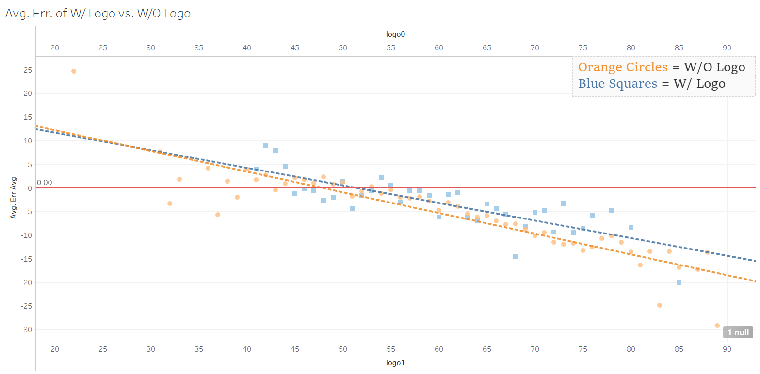
Average Error per CEO Age,
W/ Logo
Vs
W/O Logo:

Slide 16
Hypothesis for W/ Logo vs. W/O Logo
Hypothesized that logos, like glasses, would cause subjects to be estimated as older/’less young’ than photos that did not have a logo.
Believed Orange would see logos as accentuated facial features, causing them to appear as older.

Slide 17
Observations for W/ Logo vs. W/O Logo
Trendlines intersect at 28 and then diverge for the rest of the chart, with largest substantial difference in trendlines being 4 years in mid 80s.
W/ Logo trendline above W/O trendline post-intersection, showing that subjects w/ logo are consistently estimated as older or ‘less young’ than those w/o logo.

Slide 18
Observations for W/ Logo vs. W/O Logo
Before both lines intersect the zero-error line, largest difference in trendlines is 1.2 years at 48.
Diff. in trendlines only becomes significant in early 60s when diff. becomes 2 years.

Slide 19
Significant Findings for W/ Glasses vs. W/O Glasses
Hypothesis has been shown to be true.
However, diff. in error is only significant beginning at early 60s where diff. = 2 years, and at most 4.
Only ~40% of all subjects were at youngest in their early 60s and only 14% of all photos contained logos, with logos being evenly distributed across all ages, meaning only ~6% would be significantly affected.
Influence on overall age estimation of photo set is insignificant due to how small affected group is.

Slide 20
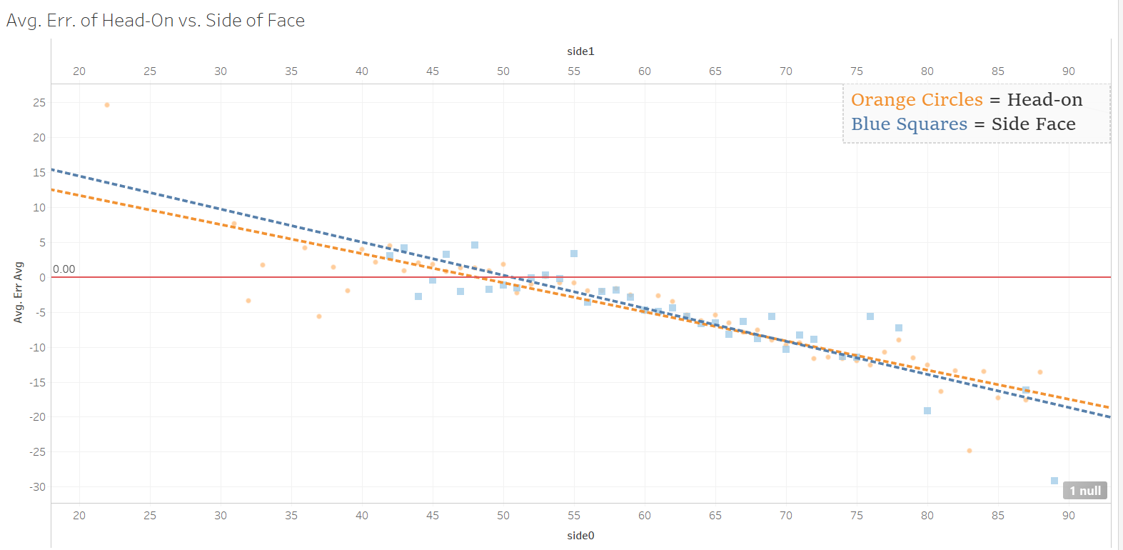
Average Error per CEO Age,
Head-On
Vs
Side of Face:
Notes:
This is our visualization of head on vs side of face, with head on being a picture with the person facing straight at the camera

Slide 21
Hypothesis for Head-On vs. Side of Face
Hypothesized that subjects directly facing the camera would appear as older/’less young’ than subjects who were turned away from the camera.
Believed that mapping of facial features for software would become more distorted the more a subject was turned away from the camera in such a way that they would estimated as appearing younger than they actually are.

Slide 22
Observations for Head-On vs. Side of Face
Largest substantial difference in trendlines is 1.5 years in early 40s and tapers until intersection at age 70.
Side Face trendline above Head-On trendline pre-intersection, showing that subjects directly facing the camera are consistently estimated as older or ‘less young’ than those turned away from the camera up until age 70.
After both lines pass zero-error line, diff. in trendlines is at most 0.9 years in early 50s and less than a year post-intersection.

Slide 23
Significant Findings for Head-On vs. Side of Face
Hypothesis has been shown to be false.
Subjects facing camera only appeared older than those turned away after 70 and had an insignificant diff. in trendline after.
At no point was the diff. in trendline values greater than 2 years, and thus, we can say that the influence of whether or not the subject is facing the camera towards their age estimation error is entirely insignificant.

Slide 24
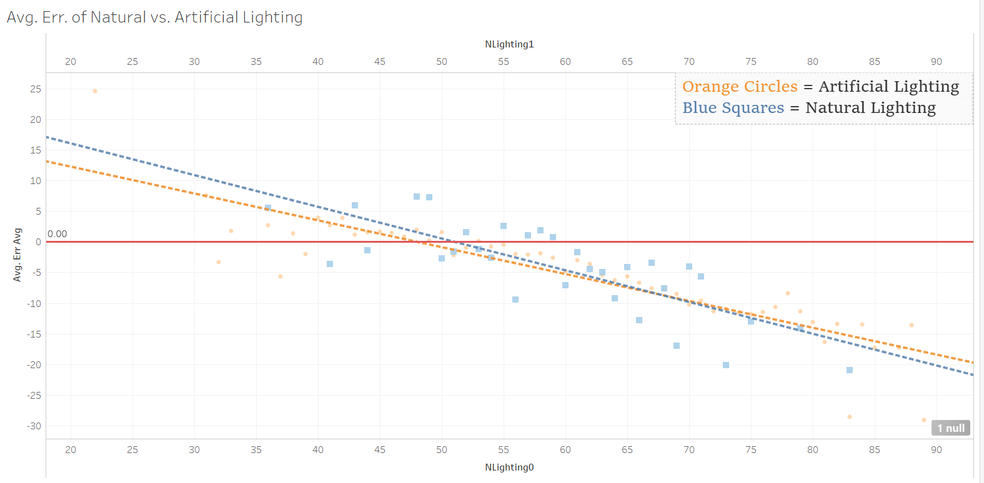
Average Error per CEO Age,
Artificial Light
Vs
Natural Light:

Slide 25
Hypothesis for Artificial vs. Natural Lighting
Hypothesized that subjects in artificial lighting would consistently appear as older/’less young’ than those in natural light.
Based on the fact that natural light tends to be more diffused than artificial lighting, causing it to be ‘softer’ and cast less intense shadows than artificial lighting, such that subjects would appear younger than they actually are.

Slide 26
Observations for Artificial vs. Natural Lighting
Largest substantial difference in trendlines is 1.8 years in early 40s and tapers until intersection at age 68.
Natural trendline above Artificial trendline pre-intersection, showing that subjects in natural lighting are consistently estimated as older or ‘less young’ than those in artificial lighting up until age 70.
After both lines pass zero-error line, diff. in trendlines is at most 1.2 years in early 50s, less than a year post-intersection.

Slide 27
Significant Findings for Artificial vs. Natural Lighting
Hypothesis has been shown to be false.
Subjects in natural light only appeared older than those in natural light up until 68 and had an insignificant diff. in trendline after.
At no point was the diff. in trendline values greater than 2 years, and thus, we can claim that the influence of type of lighting towards age estimation error is entirely insignificant.

Slide 28
Three Possible Conclusions, #1
These elements have an entirely negligible effect on error in age estimation regardless of facial recognition software used.

Slide 29
Three Possible Conclusions, #2
The sample models that Orange is trained on are so varied in relevant/related photographic elements that Orange is able to ‘see past them’ and thus is able to maintain a consistently low margin of error caused by their influence.

Slide 30
Three Possible Conclusions, #3
A combination of both.

Slide 31
Two Possible Conclusions, Conclusion
In all cases, we are left with the benefit of knowing that the possible influence of these elements is so minor, affects such a small portion of our data set, or both, that we can with high confidence consider them entirely negligible.

Slide 32
Challenges We’ve Faced
Time necessary to rate all necessary elements (plus more)
of our entire data set (2500+ photos)
The need to redo some analysis for the sake of more significant results.
Still learning the ins-and-outs of Tableau.
Photographic elements were never intentionally sought after in photos, so certain sample sizes were small.

Slide 33
Goals We’ve Achieved
Strengthened communication and coordination between team members.
Gathered large enough dated photo collections such that sample size was not an issue in accuracy of our results.
Efficiency in analyzing large datasets and the statistical measurements we calculate from them (R-squared, Mean Squared Error, etc.)
Proficiency in visualizing large datasets via R and Tableau.
Adeptness in communicating technical research to a non-technical audience.

Slide 34

Thanks!

